Slide 1
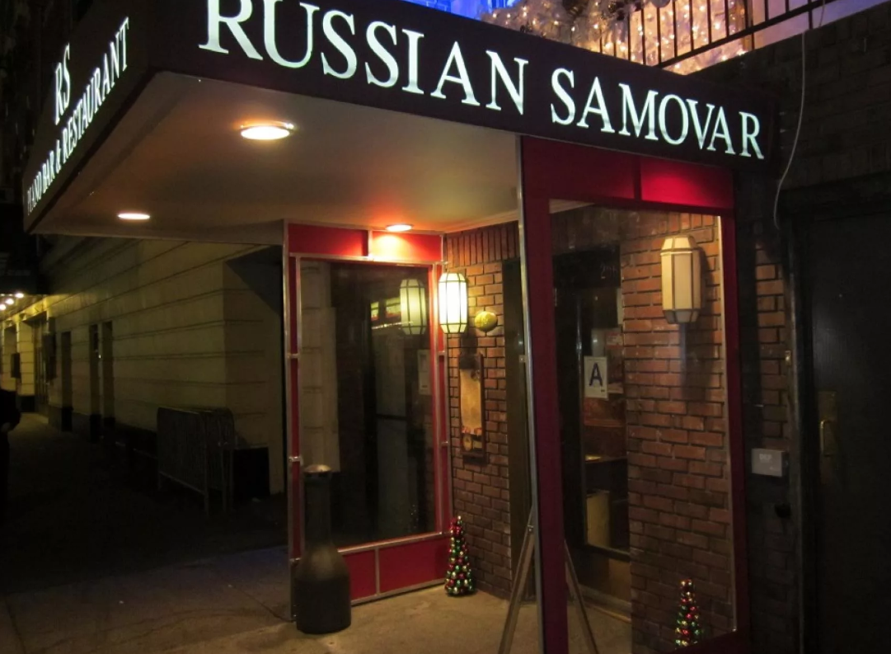

COURSERA CAPSTONE
Applied Data Science Capstone
Opening a Russian restaurant in NYC
By Vsevolod Chernakov
2020

Slide 2
Introduction
New York city has the largest Russian population in USA. According to Wikipedia, ‘The New York metropolitan area continues to be by far the leading metropolitan gateway for Russian immigrants into the United States’.
According to the 2006–2008 American Community Survey, Russian population in NYC is about 3,1% (260,821).
NYC seems to be a perfect place to open Russian restaurant.
In this final project we will try to find a best location for opening a Russian restaurant.

Slide 3
Business problem
New York city is the very diverse city – more than 800 languages are spoken in NYC. Almost all ethnic cuisines are well represented in New York City. That's why potentially new Russian restaurant can have success. However, opening a new restaurant requires serious considerations and is more complicated than it seems from the first glance. The location of the restaurant is one of the most important factors
The objective of this final project is to analyze and select the best locations in New York city for the Russian restaurant. We will use Data science methodology and instruments such as Data Analysis, Data Visualization, and Machine learning (K-means clusterization algorythm) to answer the main business question – Where in New York city should investor open a Russian restaurant.

Slide 4
Data sets and API
To answer the main business question we will use different data sets:
Information about the neighborhoods and boroughs, latitudes, and longitudes we will get from the data source: https://cocl.us/new_york_dataset
Information about each neighborhoods population we will get from the data source: https://data.cityofnewyork.us/api/views/swpk-hqdp/rows.csv?accessType=DOWNLOAD
Information about most popular languages by neighbourhood we will get from this web-page: https://www.businessinsider.com/new-york-city-most-popular-languages-by-neighborhood-2018-6
We will also use a Foursquare API to get information about nearby venues and more detailed information about existing Russian restaurants.

Slide 5
Methodology
First we will get information about NYC neighborhoods (longitude, latitude, demographics)
Then we will get information about nearby venues
Next step is to analyze and visualize the data
We will use K-means clusterization algorithm (and Elbow criterion method to find optimal number of clusters) to retrieve similar neighborhoods.
Finally with the help of above methodologies we will help the investor to decide which locations will be the best to open the Russian restaurant.

